Slide 1


Fundamentals of RM
RM System and Process
Leadership in RM
Incident Investigation
RM Tools & Challenges
RM in Industry
People & Org.
Application and Perspectives
On Becoming a
Leader in Risk Management
ENGG404 - Lecture
Final Exam Date Announcement

Slide 2
Purpose and Learning Outcomes:
Purpose of this lecture:
Communicate the date, time, and location of the Final Exam.
Communicate about how to prepare for the Final Exam
Learning Outcomes of this lecture:
You will know when and where the Final Exam will be held.
You can explain how to prepare for the Final Exam.
More information will be shared later in the term e.g. nature of questions, format, content which will be covered, etc. in Topic #65 Final Exam Date Announcement
Defer your questions, please!
Final Exam Date Announcement
2
Notes:
2

Slide 3
Final Exam Day, Time, and Location:
Location for Writing:
The final exam will be administered on-line through eClass, much the same manner as the quizzes and assignments.
The final exam will be on-campus – location TBA.
In-class proctoring.
There will be no remote on-line final exam.
You will need to bring and use your own laptop or tablet.
If this may present a problem to you, please advise Prof. Cocchio via email at Cocchio@ualberta.ca with caption
“ENGG404 2022S – Final Exam and Laptop Issue”
It has not yet been determined whether you may have access to any resources e.g. on-line or your notes.
Final Exam Date Announcement
3
Notes:
3

Slide 4
Final Exam Day, Time, and Location:
Day and Time for Writing:
Wednesday 3-August-2022 starts at 5:00PM MT (University Time), three (3) hours duration.
Conflicts, Accommodations, and Overseas Students:
There should be no final exam conflicts.
All those with accommodations will receive further information via email in the weeks prior to the exam.
Final Exam Date Announcement
4
Notes:
4

Slide 5
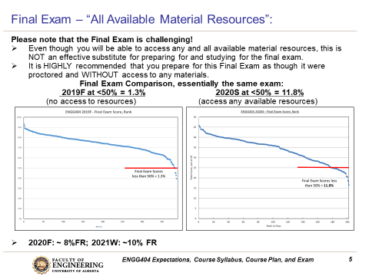
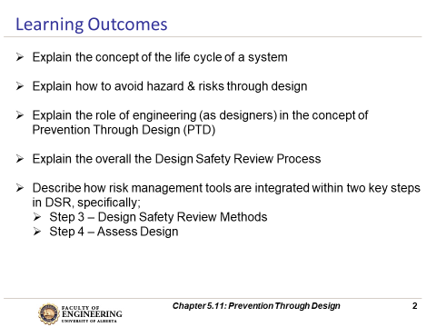
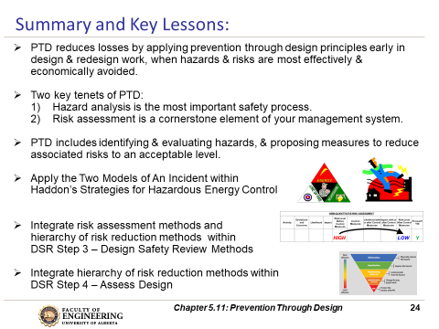
Final Exam – How to Prepare for It!
The Final Exam is challenging!
Final Exam Preparation:
Review concepts, principles, and practices AND
Apply them, AND
Assess yourself on the “Learning Outcomes”.
Q: One question that is often asked is,
"What and how do I study for the final exam for this course?"
A: The brief answer:
Each lecture Topic PPT starts with a slide that lists
the "Learning Outcomes" and ends with a slide (or
two) that lists the "Summary and Key Lessons".
Review the content on these lists to determine
your level of skill and confidence in explaining /
applying those learning outcomes and the
summary and key lessons, and as a guide to direct
your preparation efforts.
Final Exam Date Announcement
5
Notes:
5

Slide 6
Any questions?
Notes:
6

